Slide 1
Stanford ME469: SPD Computational Fluids Dynamics Research Interest
Stefan P. Domino
Computational Thermal and Fluid Mechanics
Sandia National Laboratories SAND2018-4536 PE

Slide 2
SPD Computational Fluid Dynamics Research Interest: Outline
Overview of Fluid Applications of Interest to SPD at Sandia National Labs
Evolution of how Modeling/Simulation Shaped Fire Physics
Multi-physics Coupling Examples
Wind Applications and Other non-Reacting Examples
Computational Scales of Interest
Conclusions
Lecture Overview

Slide 3
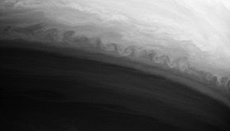
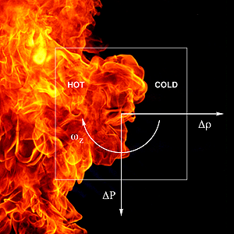
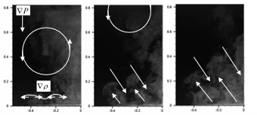
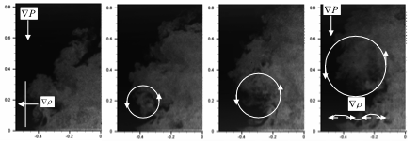
Consider the Abnormal/Thermal Environment
Characterized by a highly sooting, turbulent, reacting flow with Participating Media Radiation (PMR) and Conjugate Heat Transfer (CHT) mutiphysics coupling
Time-averaged (inset transient)
Vorticity generation

Slide 4
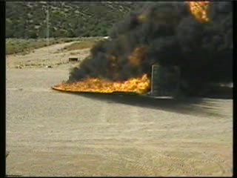
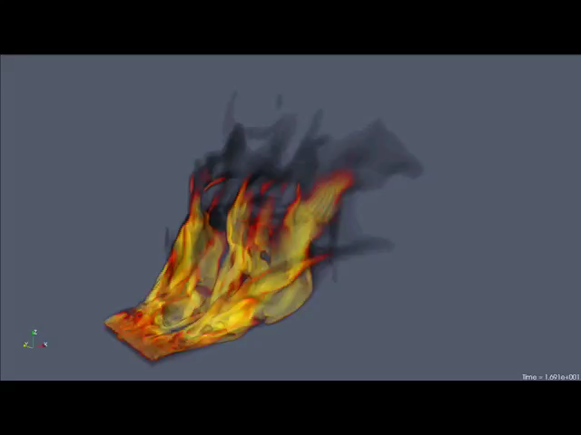
Evolution of a Mindset….. Cross Flow
LES of pulsed jet in cross flow; Coussement et al, JFM, 2012
Conclusion: The inclusion of a cross-flow wind profile couples vorticity of the pool and streamwise momentum which drives the formation of column vortices, increases the importance of mixing and, therefore, convective loads on the object become more important
Change in mindset: Invest in validation use cases to highlight the importance of fire accident scenarios in the presence of an external momentum field
Ten meter (top) experiment and
three meter (bottom) simulation

Slide 5
Evolution of a Mindset….. Whirling-like Flow
Brush fire (Curtin Springs, Australia)
Fire whirls from a 3-meter diameter pool in the Fire Laboratory for Accreditation of Modeling by Experiment, or FLAME, facility at Sandia National Laboratories. (Photo by Richard Simpson; A. Hanlin, lead experimentalist)

Slide 6
Evolution of a Mindset: From Simple to Complex
SAND2019-7052 C
Peak radiative heat fluxes to engulfed objects is a function of fuel type, pool size, obstructions/accident geometry, and presence of cross-flow
As cross-flow and geometric complexity of accident scenarios increase, SNL has found that transitioning from a Reynolds-Averaged Navier-Stokes (RANS) to a more predictive Large-eddy simulation (LES) approach is required → HPC on Next-Gen platforms
RANS-based
LES-based
Quiescent; q”_{r}
~ 100 kw/m²
Cross-flow; q”_{r}
~ 200 kw/m²
Whirls
>> 200 kw/m²
Notes:
In complex accident scenarios that involve cross wind, one can not a coupling of the cross wind and local damage state in an extreme scale. Fire whirls can drastically increase heat fluxes to objects due to increased mixing. Such events can raise nominal values from a typical quiescent flow (100 kw/m^2),beyond a typical cross flow heat fluxes of 250 kw/m^2 to 500 kw/m^2.
RANS-based approaches must model all of the turbulence – something that, in practice, is very hard. LES captures the large-scale motion and the effect of the model is smaller, however, still important to do well.
The quiescent image is probably a Gritzo experiment from SNL (5-meter JP-8)
The cross flow is a 10-meter JP-8 Jim Nakos experiment.
The whirl is from Anay
Simulation sizes increase with LES due to the required mesh resolution and inherent transient nature of the simulation.

Slide 7
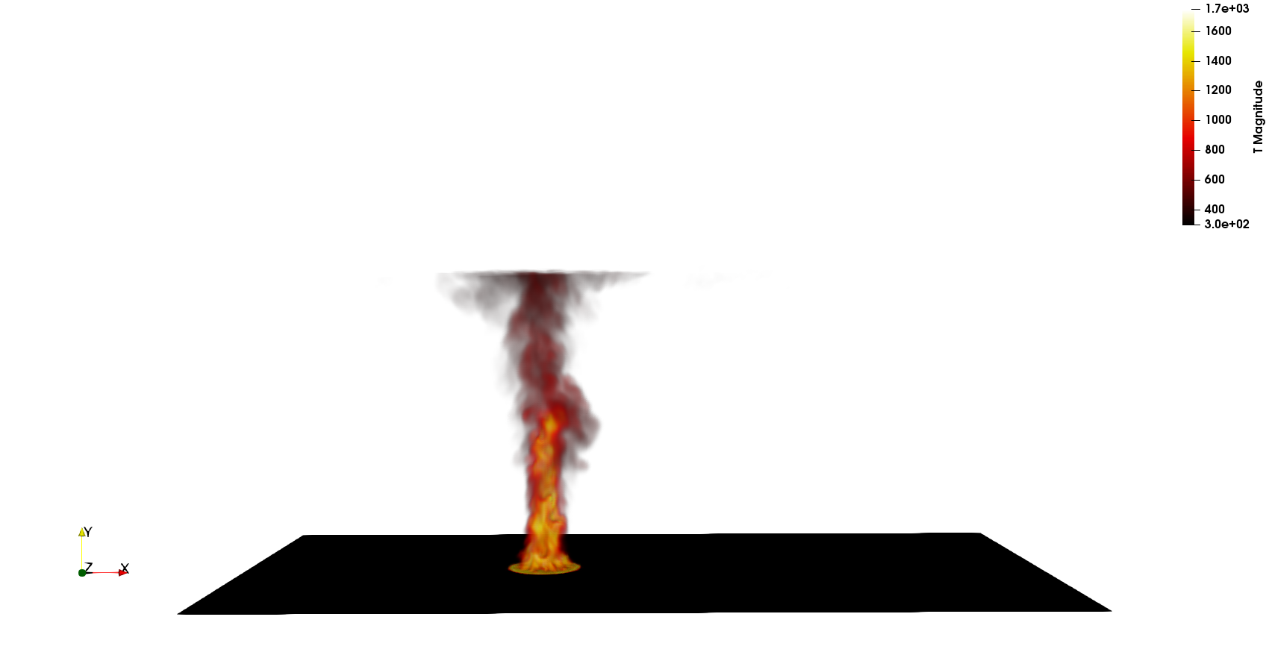
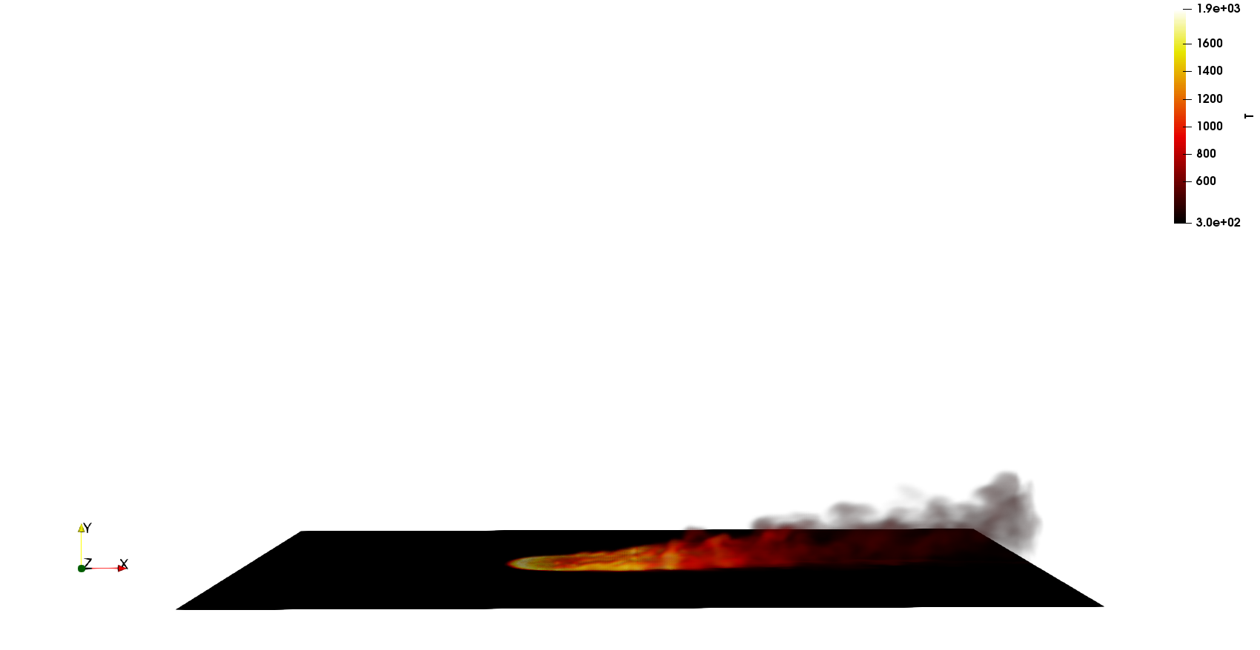
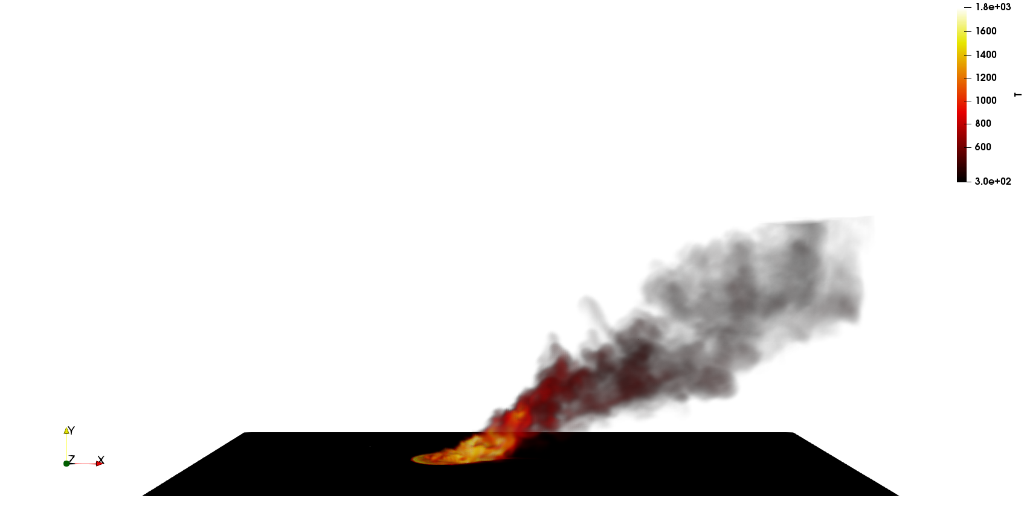
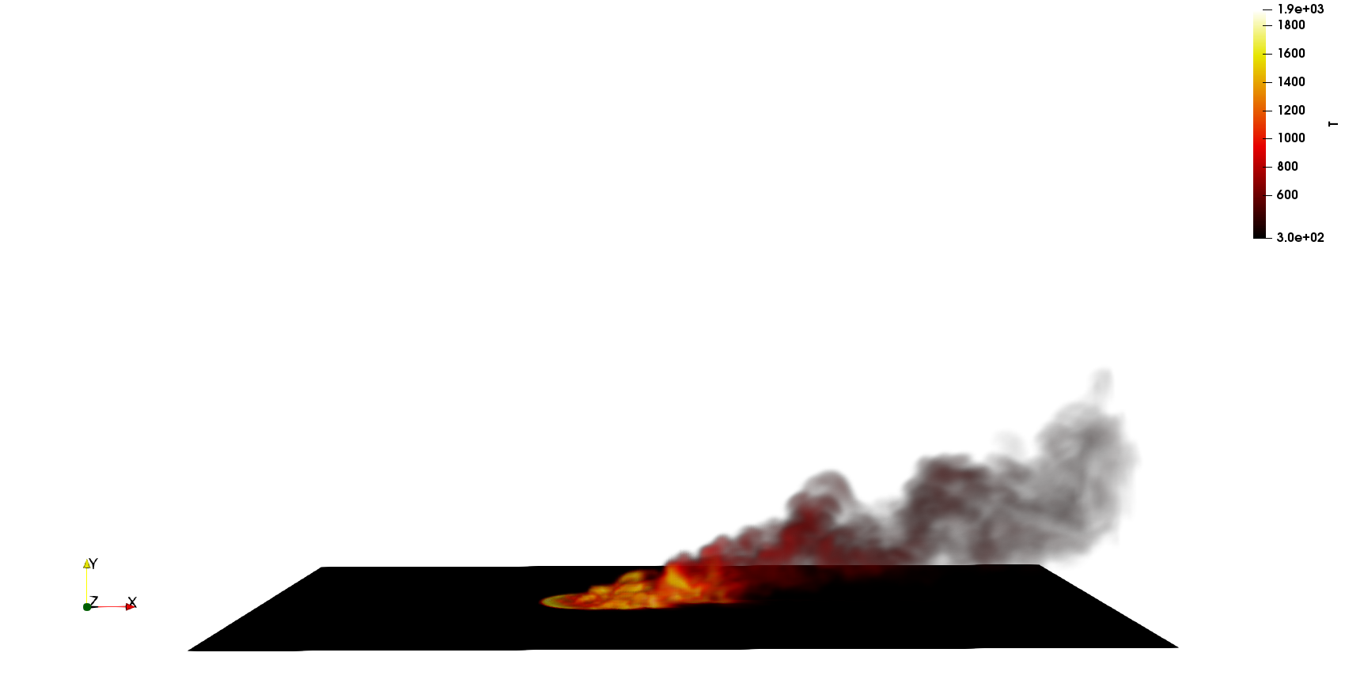
Core Research Objective: Understand Large-Scale Fire Dynamics
SAND2019-7052 C
The coupling of cross-wind with a hydrocarbon fire event drives large-scale column vortex formation – very similar to classic jet-in-cross flow behavior (see below)
Increased mixing yields increased radiative heat fluxes
Although lab-scale efforts exist for quantities such as flame drag distance and tilt angles, none exist for scale of interest to SNL, e.g., 10 meters and beyond
SNL is quantifying large-scale fire physics (Γ, θ, ect.) through theory and simulation
0.25 m/s
5 m/s
10 m/s
20 m/s
10 m pool fire
LES-based numerical study
LES of pulsed jet in cross flow; Coussement et al, JFM, 2012
Notes:
In complex accident scenarios that involve cross wind, one can note coupling between the vorticity from the plume and the momentum of the cross flow.
This coupling drives large scale downstream vortex formation (counter rotating vortex pairs) similar to what see in jet-in-xflows.
At SNL, we are driving the use of high-performance computing and LES to understand large-scale fires in cross flow.
The calculations are using Fuego and use a steady laminar flamelet model with coupling to participating media radiation. The fuel is Methane. Although no soot is transported (a developing IC capability), we have gas phase coupling between thermal radiation and gas-phase energy transport (through CO2 and H20).
End simulations are expected to be in the half-billion element count. This is required to capture the Rayleigh-Taylor (bubble-spike, heavy fluid over light fluid) instability.

Slide 8
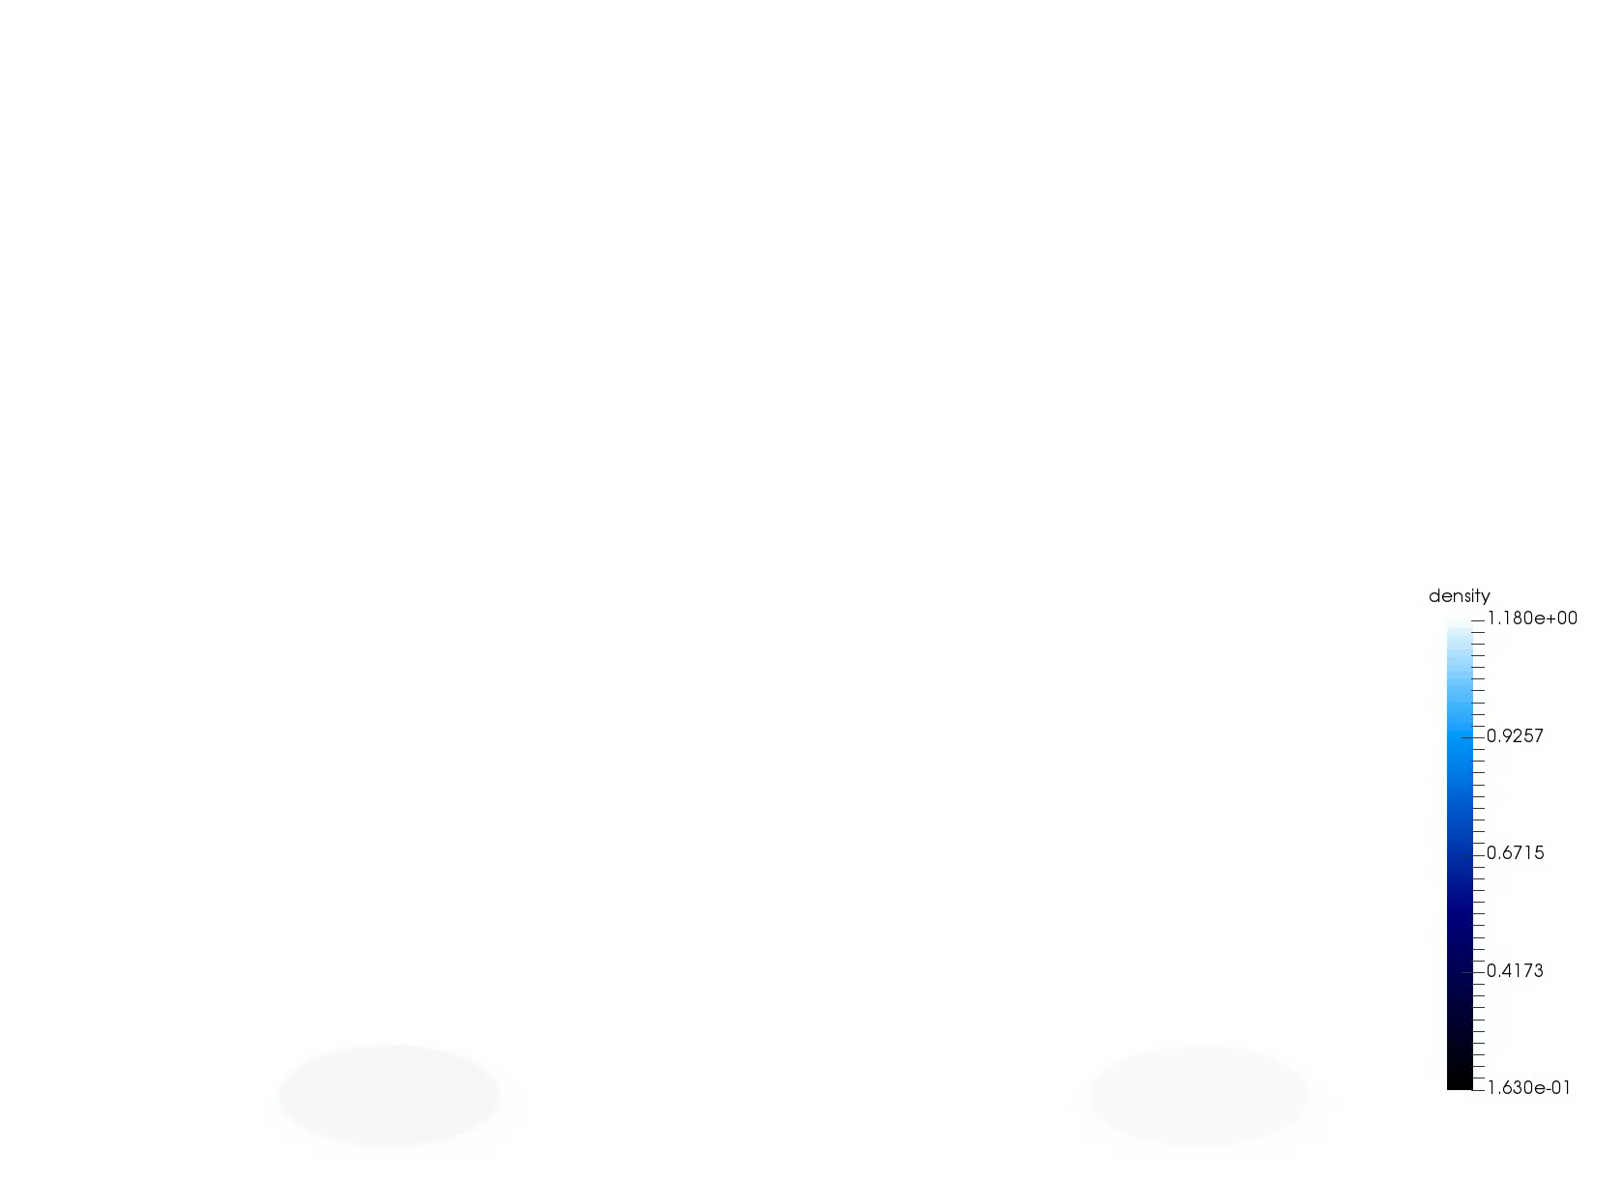
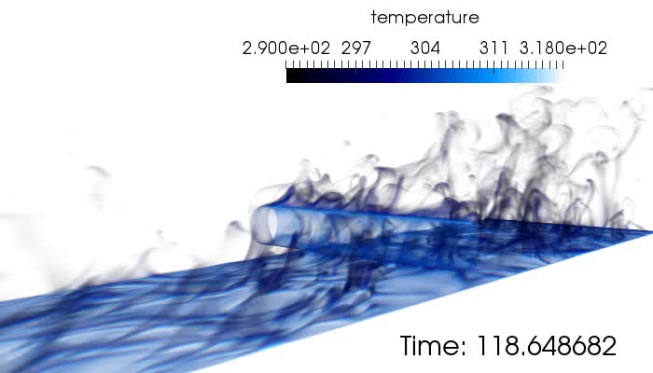
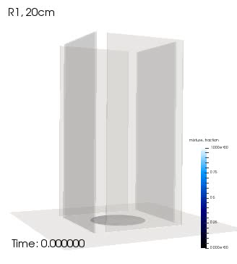
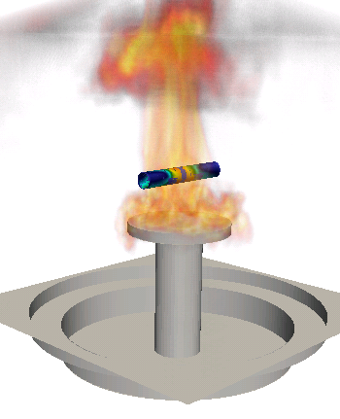
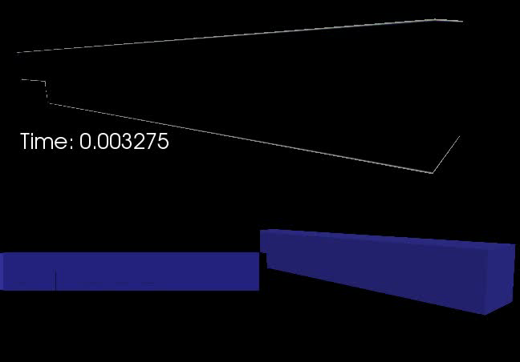
Several Multi-physics Flow Examples
Cylinder in cross flow
Helium plume (low-/high-order)
Object-in-fire
Heated backstep
Whirling behavior

Slide 9
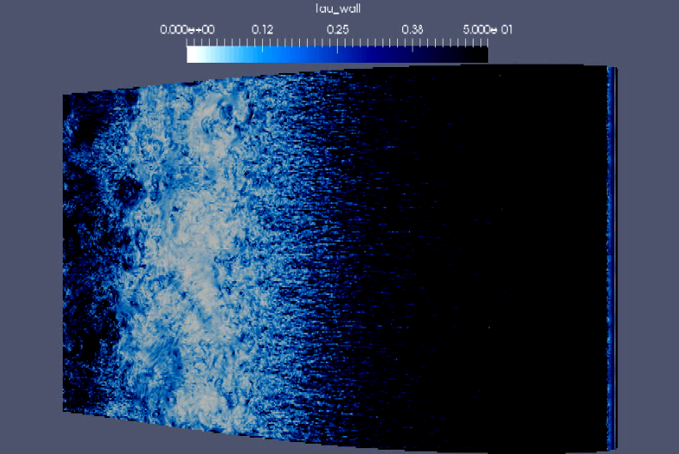
Wind Energy Applications… Towards Exascale (10¹⁸ FLOPS)
High Performance Computing (HPC) enables science
High Reynolds number flow past a wind energy turbine blade section
(Barone and Domino, 2016), ~1800 year simulation on one CPU
Late Roman Timeline 250 AD - 300 AD
250 AD: The Goths invade Anatolia (AKA, Asia Minor), in sea-borne raids they plunder Nikopolis

Slide 10
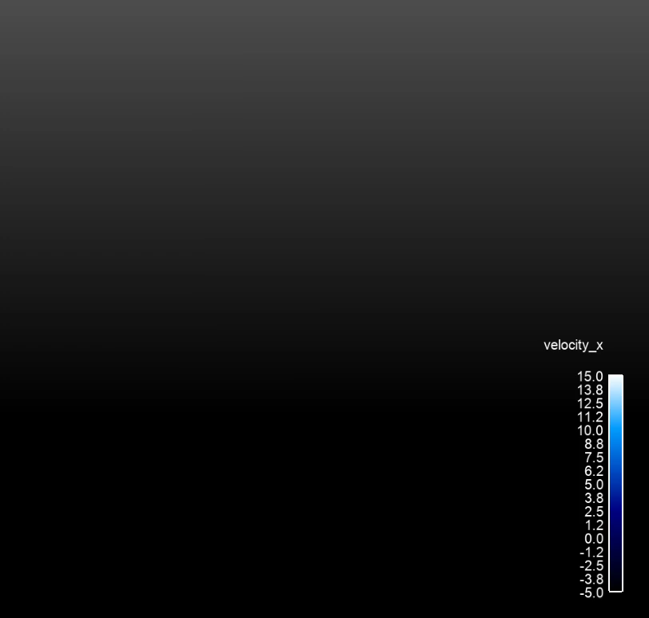
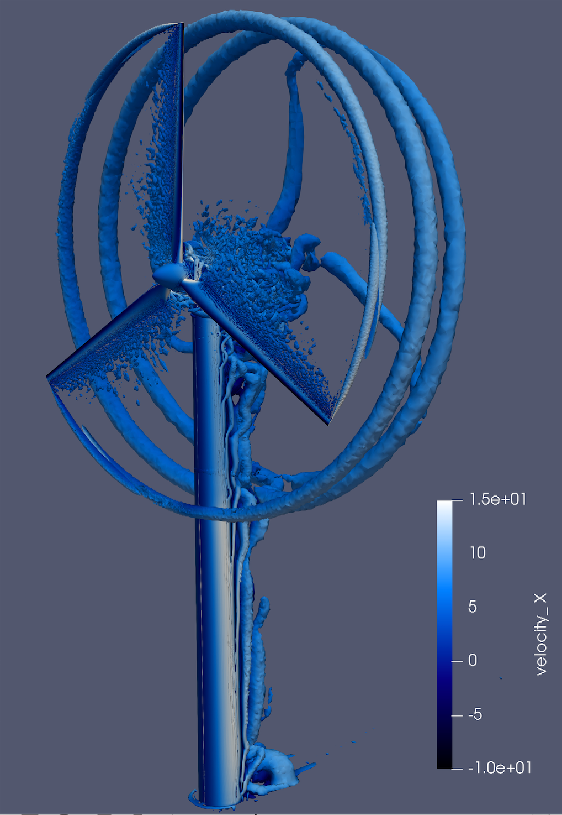
Wind Energy Applications Including Blade-Resolved Simulations
Vestas V27 225 kw wind turbine simulation

Slide 11
SPD Computational Fluid Dynamics Research Interest: Conclusion
Interest ranges from turbulent, reacting flow (fires) to wind energy applications
Multi-physics coupling allows for very complex fluid flow simulation and predictions
Most engineering and “real-world” flows include a wide range of time and length scales
HPC enables science and the pursuit of physics modeling and insight

Slide 12
Guest Lecture Overview
SPD Computational Fluid Dynamics Research Interest
Introduction to the low-Mach Number Approximation
Common low-Mach Discretization Approaches
Splitting and Stabilization Errors
Advection Operators
A Validation Methodology: Code and Solution Verification
High Performance Computing for CFD
Multiphysics Coupling
Nalu Overview

